Slide 1

CRICKET NORTH WEST
PRESENTATION and AWARDS NIGHT
Season 2025/26

Slide 2

CNW Competition Sponsor

Slide 3









CNW Community Cricket Sponsors
Choices Flooring Burnie
Coastal Engineering & Belting
Dowling McCarthy Tyres
Native Design
PlanAction
Premium Business Sales
SportsPower Burnie
TasFreight
Whitehawk Apparel

Slide 4

CNW – Thank you!
Cricket Tasmania
Lion – Sponsorship – Association and Clubs
NWTCUSA – Umpires & Scorers
Club officials, volunteers and supporters / Coaches / Players

Slide 5
Premierships 2025/26
Men’s Greater Northern Cup – Launceston
Men’s SportsPower Burnie T20 Cup – Ulverstone
Men’s 2nd Grade One-Day Cup – Devonport
Men’s Social League – Ulverstone
Women’s 1st Grade – Sheffield
Women’s Second Grade – Turners Beach
Women’s Social League (Spring) – Turners Beach
Women’s Social League (Summer) – Sheffield
Men’s u18 T20 – Burnie
Men’s u16 – Latrobe

Slide 6
CNW – 2025/26 Grand Finals
Men’s 1st Grade
  Sheffield vs Ulverstone at Latrobe Recreation Ground
Men’s 2nd Grade
  Devonport vs Sheffield at Devonport Oval

Slide 7

CNW Sponsors

Slide 8


CRICKET NORTH WEST
Men’s UNDER 16
AWARD WINNERS
2025/26

Slide 9

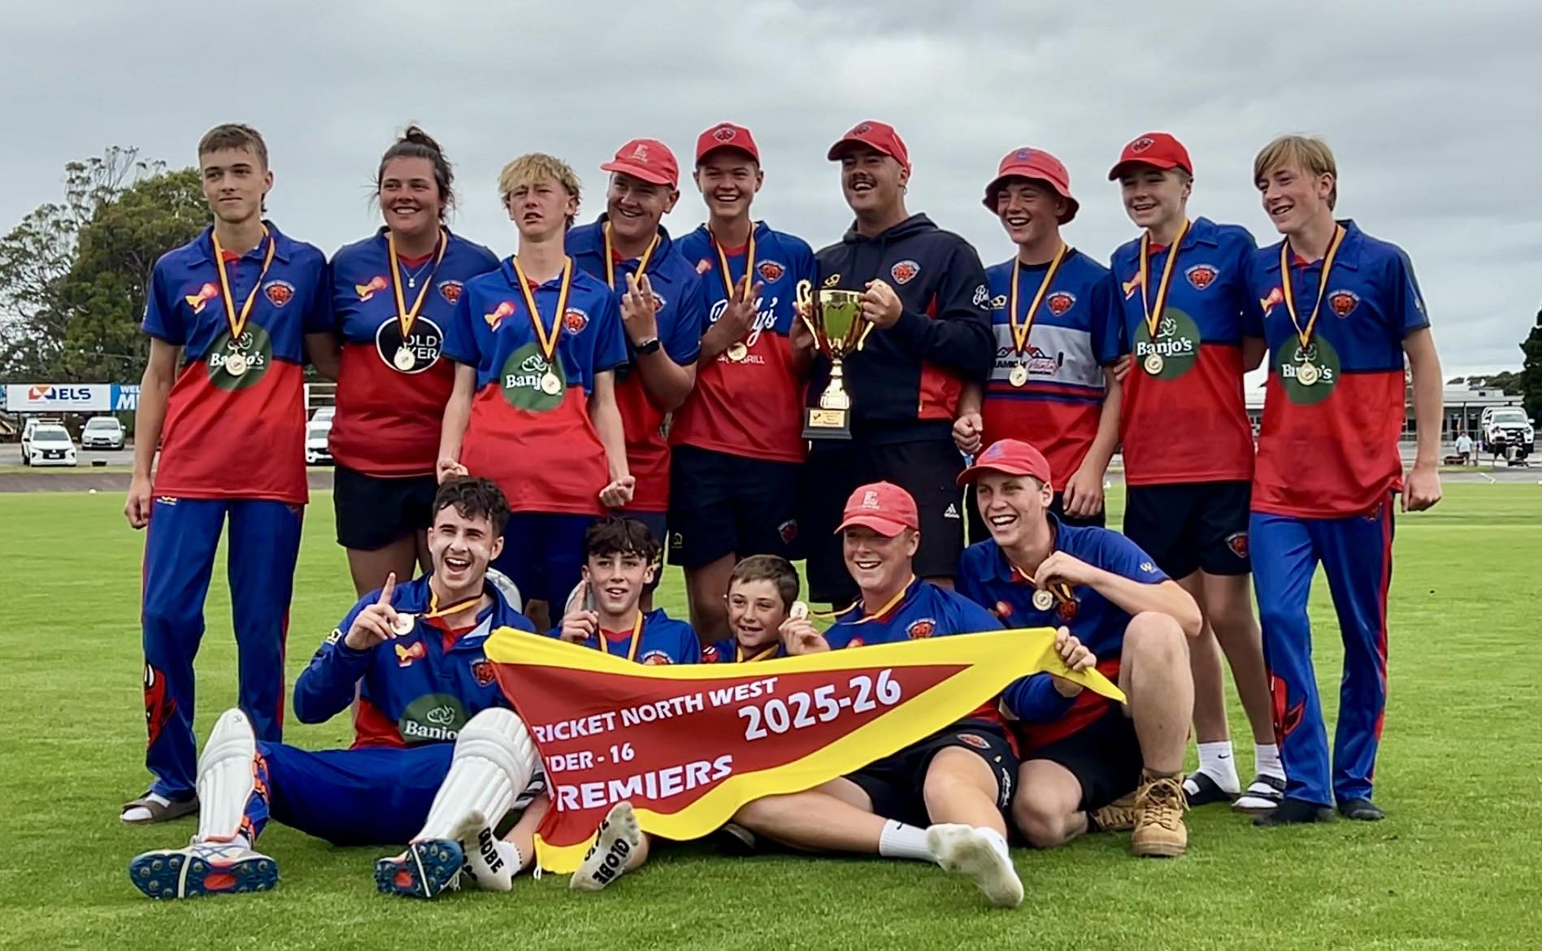
Men’s Under-16 Premiers
LATROBE

Slide 10

Men’s Under-16
- Batting Award
Qualifications – 7 innings and =/> 251 runs
NICHOLAS READY (Latrobe)
502 runs @ 55.78, HS: 100

Slide 11
Men’s Under-16
- Bowling Award
CRUZ RITCHIE (Latrobe)
16 wickets @ 9.63, BB: 5/16
Qualifications – 13 wickets and =/> 271 Balls

Slide 12

Men’s Under-16
- Wicket-Keeping Award
KEYGAN SMITH (Ulverstone)
13 Catches

Slide 13

Men’s Under-16
– Player of the Year
GEORGE RADCLIFF (Burnie)

Slide 14
CNW Sponsors

Slide 15
CRICKET NORTH-WEST
WOMEN’S SECOND GRADE WINNERS
2025/26

Slide 16
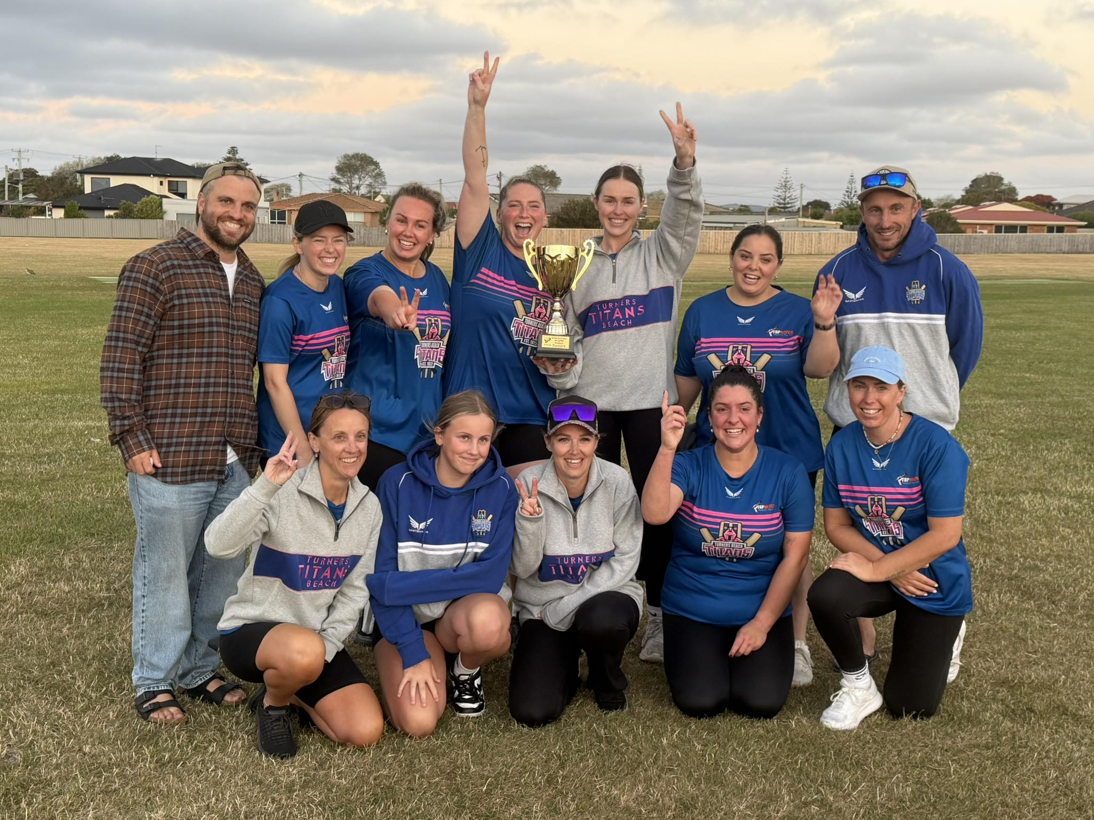
Women’s Second Grade Premiers
TURNERS BEACH

Slide 17

Women’s Second Grade - Batting Award
SHAKAYLAH GROVES (Turners Beach)
163 runs @ 81.5 HS: 34
Qualifications – 5 Innings, =/> 96 Runs

Slide 18
Women’s Second Grade - Bowling Award
Qualifications – 10 wickets and =/> 101 Balls
SHAKAYLAH GROVES (Turners Beach)
19 wickets @ 7.05 BB: 3-10

Slide 19

Women’s Second Grade – Fielding Award
BELLA WALKER-BROOKS (Devonport)
8 dismissals – 6 catches – 2 stumpings

Slide 20
Women’s Development League
– Player of the Year
SHAKAYLAH GROVES (Turners Beach)

Slide 21
Women’s Social League
- Premiers
Spring League: TURNERS BEACH
Summer League: SHEFFIELD

Slide 22
CNW Sponsors

Slide 23
CRICKET NORTH-WEST
MEN’S 2nd GRADE
AWARD WINNERS
2025/26

Slide 24
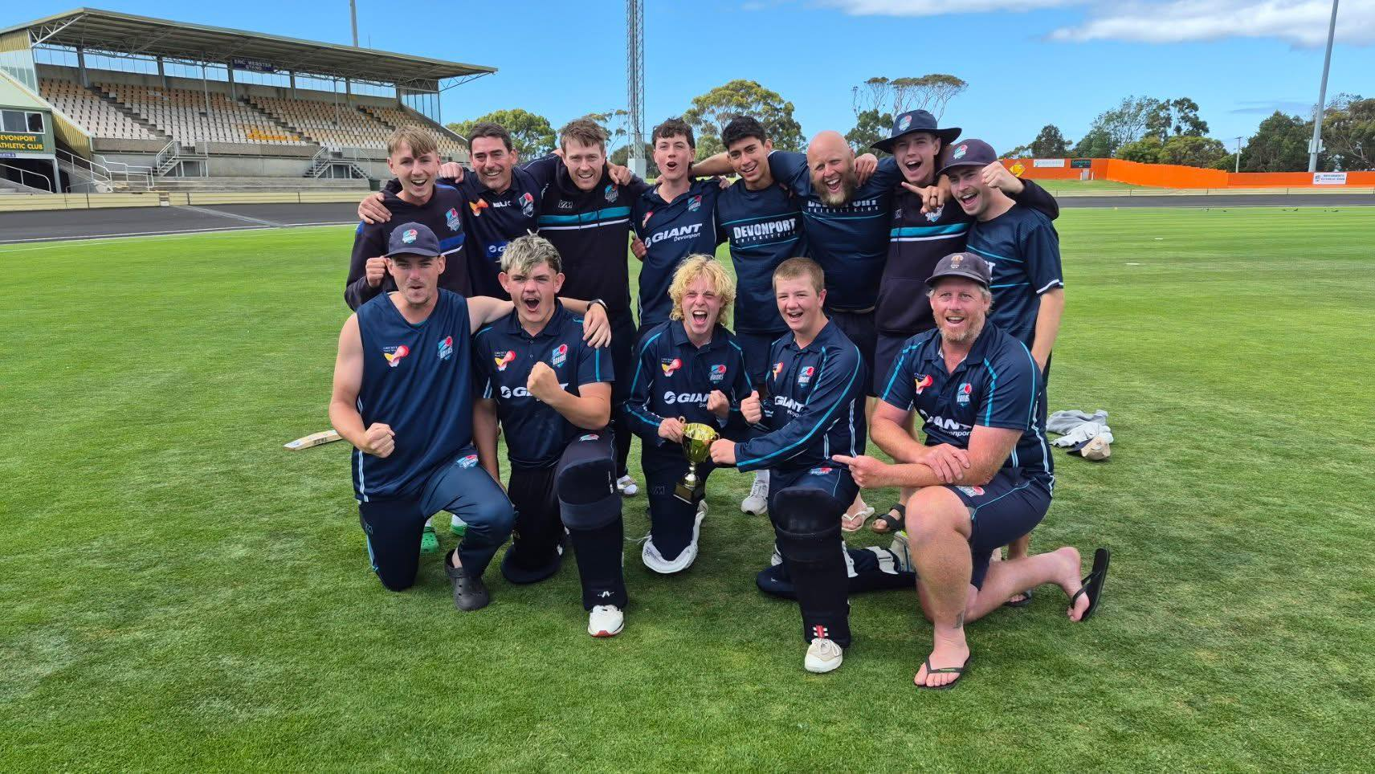
Men’s 2nd Grade
One-Day Cup Premiers
DEVONPORT

Slide 25
Men’s 2nd Grade
– Batting Award
(Qualifications: 8 innings and =/> 200 runs)
Sean Ryan (Burnie)
568 runs @ 56.8, HS: 165*

Slide 26

Men’s 2nd Grade
- Bowling Award
(Qualifications: 480 balls and =/> 15 wickets)
JARROD WILLCOX (Wynyard)
16 wickets @ 9.81, BB: 7-12

Slide 27

Men’s 2nd Grade
- Wicket-Keeping Award
CONNOR HINRICHSEN (Sheffield)
19 Dismissals
- 18 catches and 1 stumpings

Slide 28
Men’s 2nd Grade Awards
Player of the Year Leaderboard
Drew Allen (Ulverstone) – 14 votes
2. P Fulton (Latrobe) – 12 votes
=3. N Hayes (Burnie) / S Ryan (Burnie) – 11 votes
=5. B Wilcox (Wynyard) / L French (Devonport) - 9 votes
7. B Moore (Devonport) - 8 votes
8. K Lee (Sheffield) - 7 votes
=9. A Charlesworth (Latrobe) / J Doherty (Devonport) / L Reid (Devonport) - 6 votes

Slide 29
Men’s 2nd Grade
- Player of the Year
DREW ALLEN (Ulverstone)

Slide 30
Men’s Social League Premiers
ULVERSTONE

Slide 31
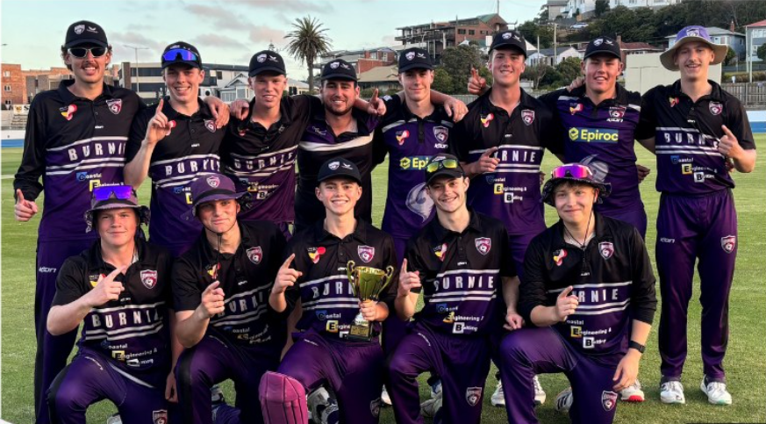
Men’s Under 18s T20 Premiers
BURNIE

Slide 32
CNW Sponsors

Slide 33
CRICKET NORTH WEST
ASSOCIATION AWARDS
2025/26

Slide 34

Umpire of the Year
This award is voted on by 1st Grade Captains on a 4, 3, 2, 1 basis.
Scott Pearce: 23 Votes
Darren Dietz: 15 Votes
Juan Salter: 10 Votes
Ken Collyer: 5 Votes
Sam O'Keefe: 4 Votes
Colin Bruhn: 2 Votes
Russell Hogarth: 1 Votes

Slide 35
Umpire of the Year
SCOTT PEARCE

Slide 36

Lord’s Taverners TAS - Spirit of Cricket Award
Umpires vote after each senior game, rating clubs 0-4 on the following criteria:
Respect for the game
Respect for the opposition
Respect for the role of the umpire
PREVIOUS WINNERS (22)
Burnie Hurricanes (6)
Devonport (4)
Latrobe (1)
Sheffield (5)
Ulverstone (4)
Wynyard (2)

Slide 37
Lord’s Taverners TAS
- Spirit of Cricket Award
Previous Winners
2003/04 - Burnie | 2015/16 - Devonport
2004/05 - Ulverstone | 2016/17 - Wynyard
2005/06 - Ulverstone | 2017/18 - Devonport
2006/07 - Devonport | 2018/19 - Devonport
2007/08 - Ulverstone | 2019/20 - Burnie
2008/09 - Ulverstone | 2020/21 - Burnie
2009/10 - Wynyard | 2021/22 - Sheffield
2010/11 - Sheffield | 2022/23 - Sheffield
2011/12 - Latrobe | 2023/24 - Sheffield
2012/13 - Burnie | 2024/25 – Sheffield
2013/14 - Burnie | 2025/26 – ???
2014/15 - Burnie

Slide 38
Lord’s Taverners TAS
- Spirit of Cricket Award
2025/26 RESULTS
  Devonport 2.79
  Sheffield 2.78
  Burnie 2.72
  Wynyard 2.60
  Ulverstone 2.58
  Latrobe 2.46

Slide 39
Lord’s Taverners TAS
– Spirit of Cricket Award
2025/26 WINNER
DEVONPORT CRICKET CLUB

Slide 40
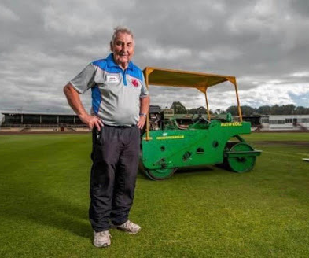
Ray Read Spirit of Cricket Award
Ray Read Spirit of Cricket Award
The Ray Read Spirit of Cricket Award is to be given to an individual who has shown on-field and/or off-field actions that exemplifies the true spirit of cricket something, which Ray was very much an admirer of.

Slide 41
Ray Read Spirit of Cricket Award
JACOB GRANGER (Burnie)

Slide 42
Gordon Rimmer Club Championship
Points earned for each team in each grade are multiplied by a weighting factor and added together to determine the Club Championship.
The Award is named after Gordon Rimmer, a CNW Life Member and Association Secretary from 1989 – 2001.

Slide 43
Gordon Rimmer Club Championship
– Previous Winners
2003/04 - Devonport | 2014/15 - Burnie
2004/05 - Wynyard | 2015/16 - Burnie
2005/06 - Devonport | 2016/17 - Burnie
2006/07 - Ulverstone | 2017/18 - Devonport
2007/08 - Ulverstone | 2018/19 - Devonport
2008/09 - Ulverstone | 2019/20 - Ulverstone
2009/10 - Burnie | 2020/21 - Burnie
2010/11 - Ulverstone | 2021/22 - Burnie
2011/12 - Ulverstone | 2022/23 - Latrobe
2012/13 - Ulverstone | 2023/24 - Sheffield
2013/14 - Ulverstone | 2024/25 - Sheffield
 | 2025/26 - ???

Slide 44
Gordon Rimmer Club Championship
2025/26 WINNER
SHEFFIELD CRICKET CLUB

Slide 45
Gordon Rimmer Club Championship
2025/26 RESULTS
Sheffield 423 points
Devonport 383 points
=Ulverstone / Burnie 326 points
Latrobe 273 points
Wynyard 268 points

Slide 46
CNW Players - Greater Northern Raiders
Men (4) | Women (8)
Eli Sheean | April Allison
Toby Hutton | Hayley Marshall
Sam Omahony | Montana Bradley
Brayden DeVries | Chloe Casey
 | Payton Fulton
 | Payton Stewart
 | Hannah Magor
 | Tayla Wigg

Slide 47
CNW Players – Tasmanian Representatives
MEN | WOMEN
 | Chloe Casey – Women's Under 16s, 19s and Tasmanian Second XI
 | Montana Bradley – Tasmanian Second XI

Slide 48
CNW Sponsors

Slide 49
CRICKET NORTH-WEST
WOMEN’S 1ST GRADE
AWARD WINNERS
2025/26

Slide 50
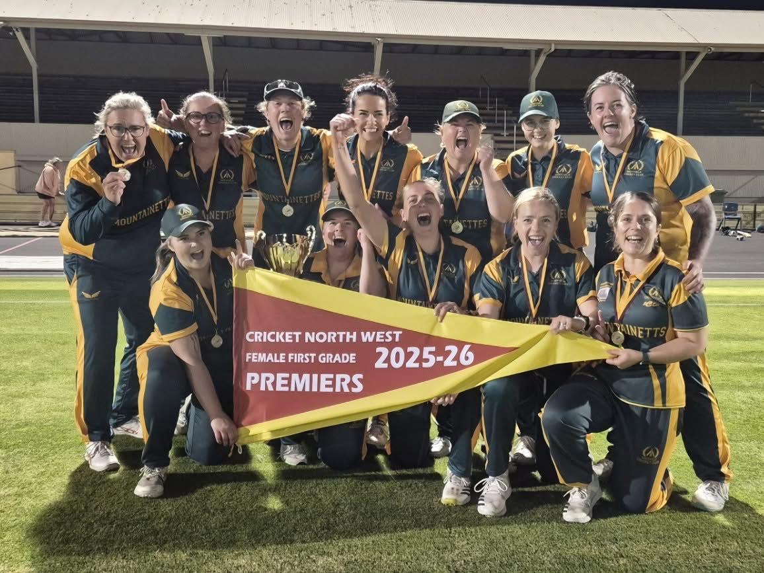
Women’s 1st Grade Premiers
SHEFFIELD

Slide 51
Women’s 1st Grade
- Batting Award
MONTANA BRADLEY (Wynyard)
308 runs @ 308, HS: 64*

Slide 52
Women’s 1st Grade
- Bowling Award
KAHLA SUMMERS (Sheffield)
12 wickets @ 11.92, BB: 4/9

Slide 53
Women’s 1st Grade – Fielding Award
SAMANTHA HARDY (Sheffield)
11 dismissals
– 4 catches and 7 stumpings

Slide 54

Mel Scolyer Medal
The Mel Scolyer Medal recognises the competition’s best local Women’s Under-21 player.
The highest finishing Under-21 Woman from Player of the Year voting.

Slide 55
Mel Scolyer Medal
2025/26 Votes
Payton Fulton (Latrobe): 12 Votes
Payton Stewart (Wynyard): 4 Votes
Ursula Poole (Wynyard): 3 Votes
Chloe Casey (Devonport), Kalea Leary (Wynyard), Talia Bartlett (Devonport): 2 Votes

Slide 56
Mel Scolyer Medal
– 2025/26 Winner
PAYTON FULTON (Latrobe)

Slide 57
Women’s 1st Grade
- Player of the Year
Leaderboard:
Montana Bradely (Wynyard), Georgia King (Sheffield) – 17 votes
Payton Fulton (Latrobe) – 12 votes
Martina Steven (Devonport) – 11 votes
Georgia Anderson (Sheffield) – 8 votes
April Allison (Wynyard) – 7 votes
Kahla Summers (Sheffield), Samantha Hardy (Sheffield) – 6 votes
Kate Chaplin (Latrobe) – 5 votes

Slide 58
Women’s 1st Grade
- Player of the Year
GEORGIA KING (Sheffield) &
MONTANA BRADLEY (Wynyard)

Slide 59


CNW Women’s
ALL-STAR TEAM 2025/26

Slide 60
CNW Women’s All-Star Team
Montana Bradley (Wynyard)
Georgia King (Sheffield) – Captain
Payton Fulton (Latrobe)
Martina Steven (Devonport)
Georgia Anderson (Sheffield)
Kate Chaplin (Latrobe)
Esther Magor (Latrobe)
Samantha Hardy (Sheffield) – Wicket Keeper
Kahla Summers (Sheffield)
Chloe Casey (Devonport)
Kalea Leary (Wynyard)
Rachel Kirkwood (Latrobe) – 12th

Slide 61
CNW Sponsors

Slide 62
CRICKET NORTH WEST
MEN’S 1ST GRADE
AWARD WINNERS
2025/26

Slide 63

Sportspower Burnie CNW T20 Competition
- Premiers
ULVERSTONE
Player of the Match
- BRAYDEN DEVIRES
(Ulverstone)

Slide 64
SportsPower Burnie
CNW T20 Competition
- Player of the Year Award
DILAN SANDAGIRIGODA (Devonport)

Slide 65
Men’s 1st Grade
- Danny Buckingham Batting Award (Qualification: 8 innings & =/>300 runs)
ALEX KING (Sheffield)
506 runs @ 46, HS: 106

Slide 66
Men’s 1st Grade
- David Mullett Bowling Award (Qualification: 600 balls & =/>20 wickets)
JUDD BROOMHALL (Devonport)
31 wickets @ 12.23, BB: 4/22

Slide 67
Men’s 1st Grade
- Wicket-Keeping Award
James Jennings (Sheffield)
29 Dismissals
- 25 catches and 4 stumpings

Slide 68
CNW Sponsors

Slide 69
Ben Hilfenhaus Medal
The Ben Hilfenhaus Medal recognises the competition’s best Men’s Under-21 player.
Ben Hilfenhaus – career included:
- 104 first class games / 378 wickets at 29.34
– 27 tests / 99 wickets at 28.5
First Grade captains are asked to award 3, 2, 1 votes to players based on this season’s performances in 1st Grade.

Slide 70
Ben Hilfenhaus Medal
– Past Winners
2016/17 - Brodie Hayes (Burnie) & Jacob Webb (Latrobe)
2017/18 – Shaun Redman (Burnie)
2018/19 – James Odgers (Burnie)
2019/20 – James Odgers (Burnie)
2020/21 – Blake Weeks (Latrobe)
2021/22 – Kaleb Williams (Latrobe)
2022/23 – Alex Wynwood (Ulverstone)
2023/24 - Ollie Walker (Burnie)
2024/25 – Ollie Walker (Burnie)
2025/26 -

Slide 71
Ben Hilfenhaus Medal
2025/26 Votes
Ethan Clark (Sheffield): 18 Votes
Judd Broomhall (Devonport): 9 Votes
Theo Marshall (Ulverstone): 4 Votes
Toby Hutton(Ulverstone), Spencer Grove (Burnie), Eamon Young (Latrobe), Flynn Gunston (Wynyard), Jack Hayes (Latrobe) : 1 Vote

Slide 72
Ben Hilfenhaus Medal
– 2025/26 Winner
Ethan Clark (Sheffield)

Slide 73


Men’s Greater Northern Cup - Premiers
Launceston CC 9/201 (50)
Defeated
Mowbray CC 10/140 (43.3)

Slide 74
Men’s Greater Northern Cup
- Player of the Year - Leaderboard
1ST – Ethan Clark (Sheffield), Shaun Redman (Burnie) – 12 votes
2nd – Daniel Murfet (Westbury), Jarrod Freeman (Mowbray), John hayes (Mowbray) – 10 votes
3rd – Oliver Wood (Westbury) - 9 votes
4th – Will Bennett (Launceston) – 8 votes
5th – Eli Sheean (Devonport) Dhanushka Lahiru Kumara(Wynyard) - 7 votes

Slide 75

Men’s Greater Northern Cup
- Player of the Year
ETHAN CLARK (Sheffield) &
SHAUN REDMAN (Burnie)

Slide 76
Men’s 1st Grade
- Player of the Year
Men’s 1st Grade Player of the Year - Leaderboard
1st – Shaun Redman (Burnie) – 17 votes
2nd – Ethan Clark (Sheffield) – 15 votes
3rd – Eli Sheean (Devonport) – 12 votes
=4th – Alex King (Sheffield), Dhanushka Lahiru Kumara(Wynyard) – 10 votes
6th – Marc Simonds (Sheffield) – 8 votes
=7th – Jakob Smith (Ulverstone), Kaleb Williams (Latrobe),
Mark Saunders (Sheffield), Toby Hutton (Ulverstone) – 6 Votes

Slide 77
Men’s 1st Grade
- Player of the Year
SHAUN REDMAN (Burnie)

Slide 78
CNW Men’s
ALL-STAR TEAM 2025/26

Slide 79
CNW Men’s All-Star Team
Miles Barnard (Devonport)
Jordan Kelly (Ulverstone) – Wicket Keeper
Ethan Clark (Sheffield)
Jack Pearce (Ulverstone)
Alex King (Sheffield)
Shaun Redman (Burnie)
Marc Simonds (Sheffield) – Captain
Brandon King (Ulverstone)
Judd Broomhall (Devonport)
Kurt Lamprey (Burnie)
Kaleb Williams (Latrobe)
Matthew Varner (Ulverstone) – 12th

Slide 80
CRICKET NORTH WEST
PRESENTATION AND AWARDS NIGHT
Conclusion

Slide 81
CNW Sponsors

